Slide 1
Elevating United Airlines' Food & Beverage Services: Data-Driven Analysis and Strategies for Enhanced Customer Satisfaction
A case study by:- Yash Yadav 2020UIT3119 IT-NSUT’24

Slide 2
Table of Contents
01
02
03
What affects the customer satisfaction the most?
Meal Planning
Customer Feedback Analysis
04
05
Pre Order Data Analytics
Business Suggestions

Slide 3
Tech Stack Used
Python for machine learning. Libraries used: Pandas, numpy, sklearn, SHAP,matplotlib, re, nltk, gensim, collections, wordcloud
BiqQuery, LookerStudio, SQL.
Link for notebooks for What affects customer satisfaction the most and Customer feedback analysis.
https://colab.research.google.com/drive/1l2O4hrxEBFXxXMhi7cf1EOuViDBTAAuK?usp=sharing
https://colab.research.google.com/drive/1bQuQjdGWNyxTFkQerlW0DI5TaHfjvaWR?usp=sharing

Slide 4
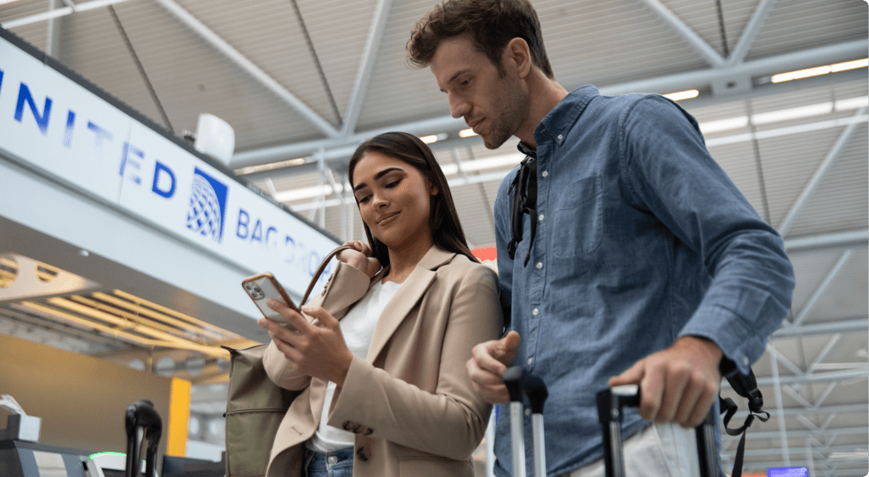
01
What affects the customer satisfaction the most?
Unveiling key factors that derive customer satisfaction using ML

Slide 5
Introduction
Data Cleaning
Explored dataset named “inflight satisfaction score”
The table includes 31 columns where each row represents a customers flight experience and other flight details.
The key insight that we aim to achieve from that table is that which of these features most affects customer satisfaction.
Addressed missing values through appropriate strategies
Eliminated rows/ columns with unmanageable missing data
Excluded less relevant columns to focus analysis
Dropped columns- ['cabin_name','loyalty_program_level','departure_gate','arrival_gate','media_provider','equipment_type_code','fleet_type_description','response_group','driver_sub_group1','driver_sub_group2','arrival_delay_minutes']

Slide 6
Classification Models
Feature Importance Analysis
Due to categorical data, employed one-hot encoding for feature transformation.
We our classifying into 2 labels-Satisfied and Dissatisfied
Implemented three classification models: Logistic Regression, Decision Tree, SVM
Logistic regression had the highest accuracy among the models hence selected it for further analysis. Even though it is a regression model it is well suited for binary classification.
Utilized SHAP for feature importance interpretation.
Uncovered influential factors impacting decision-making process.

Slide 7
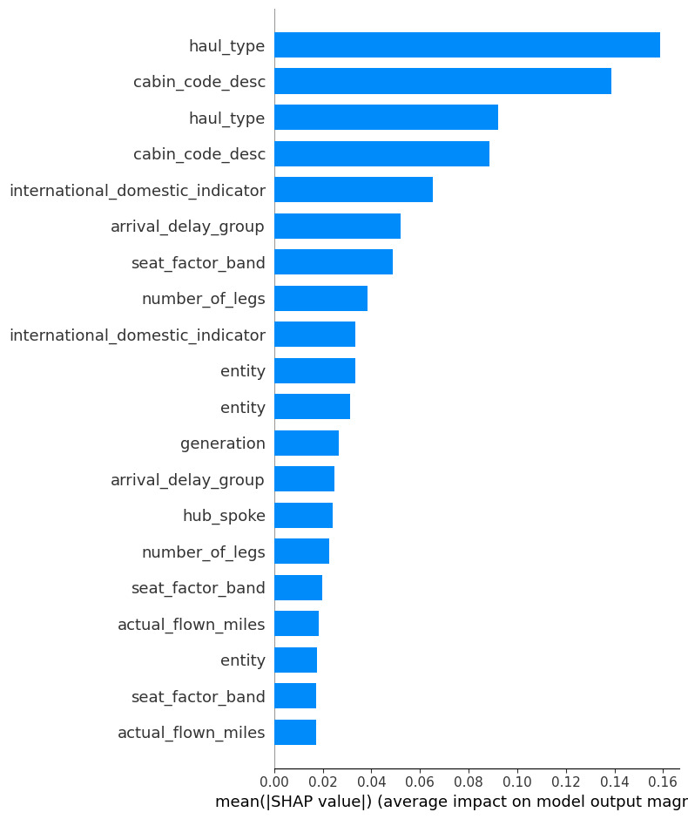
Key Insights
According to the SHAP results on the left. We can observe that the features that most impact the customer satisfaction are as follows*:
Haul_type: Long, Medium, Short
Cabin_code_desc: Economy, Business, United premium plus
International_domestic_indicator:International or domestic
Arrival_delay_group:early & on time, delayed
Seat_factor_band:90+, 80+, 70+, 0 to 70
And so on…
*Few features and repeated due to one- hot encoding but this can be ignored

Slide 8
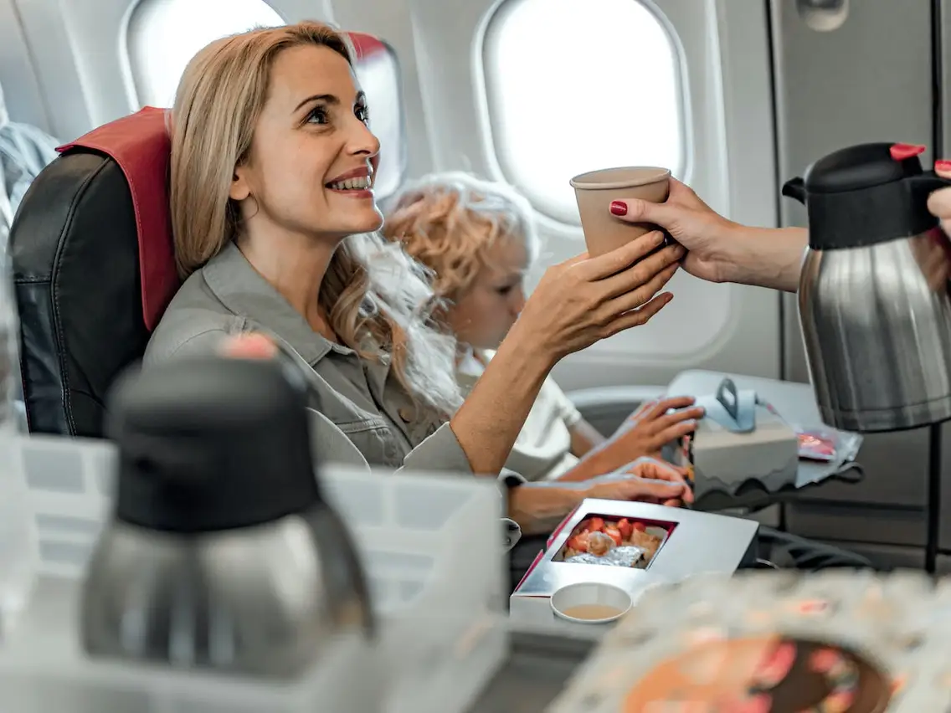
02
Meal Planning
Examining Opportunities for Enhancement in United Airlines' Meal Planning Process

Slide 9
50% +
Of all planned meals are WASTED!!

Slide 10
Introduction
Explored dataset named “Inflight service_inventory data”
This table talks about the different meals planned for each flight, their quantities , codes and how many of those are consumed.
The data is analysed using SQL on BigQuery and the results and visualised using LookerStudio.
To calculate the percentage of each meal wasted , the following query is implemented.
SELECT
entree_description,
(SUM(planned_entree_count - consumed_entree_count) / SUM(planned_entree_count)) * 100 AS percentage_wasted
FROM `stalwart-summer-397109.UAhack.inflight_inventory`
WHERE planned_entree_count > consumed_entree_count
GROUP BY entree_description;

Slide 11
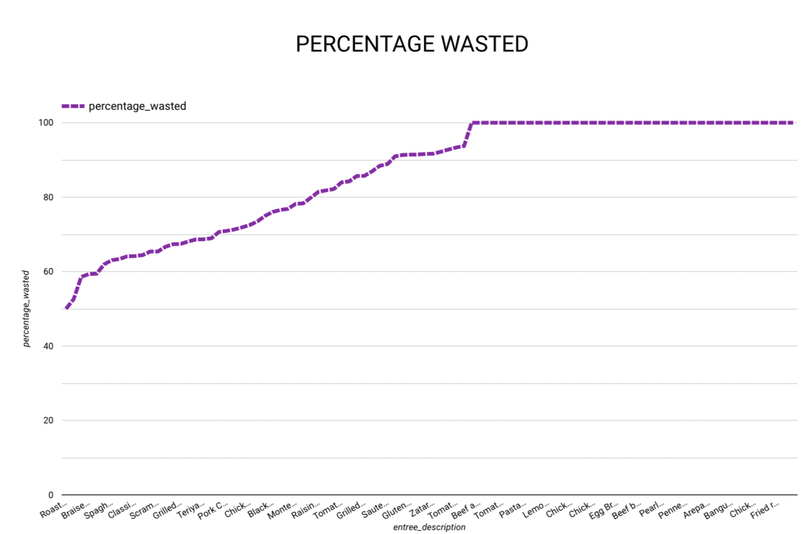
The insights from the query in the previous slide are as follows:
A large number of meals are being 100% wasted as seen in the graph.
Even the best-seller meals have a lot of wastage.
Nearly 50% or more of the planned meals are not consumed.
This shows us that there is a clear overestimation of the quantity of planned meals.

Slide 12
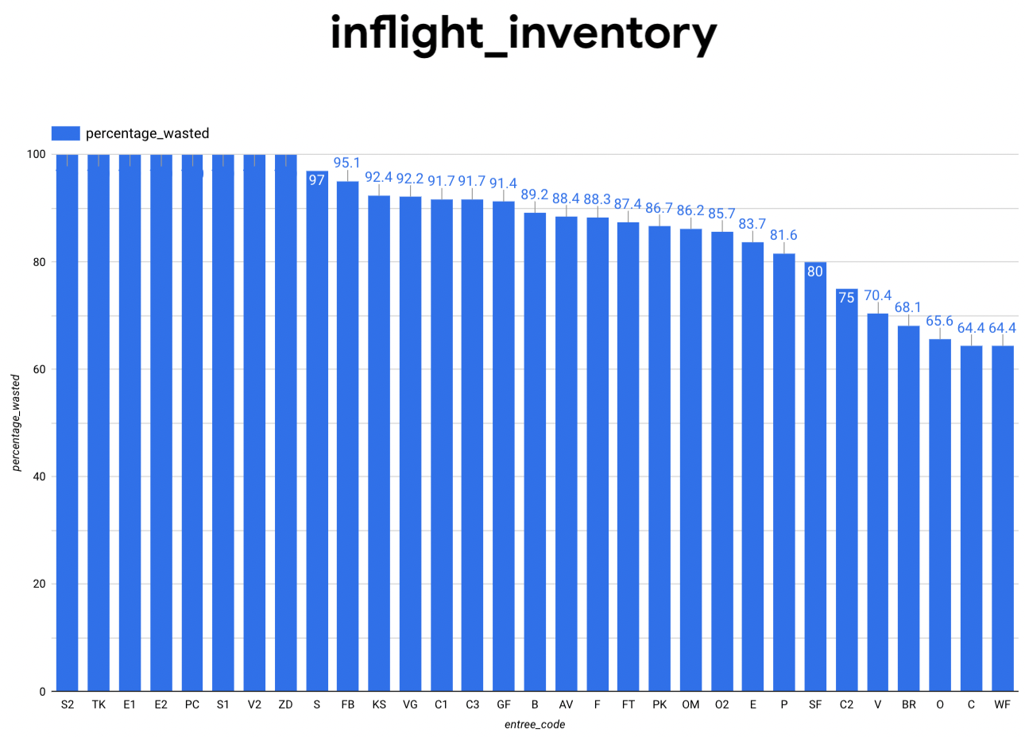
The bar graph indicates the distribution of wasted meals based on entree codes, listed in descending order of wastage as follows:
Query used:-
SELECT
entree_code,
(SUM(planned_entree_count - consumed_entree_count) / SUM(planned_entree_count)) * 100 AS percentage_wasted
FROM `stalwart-summer-397109.UAhack.inflight_inventory`
WHERE planned_entree_count > consumed_entree_count
GROUP BY entree_code;

Slide 13
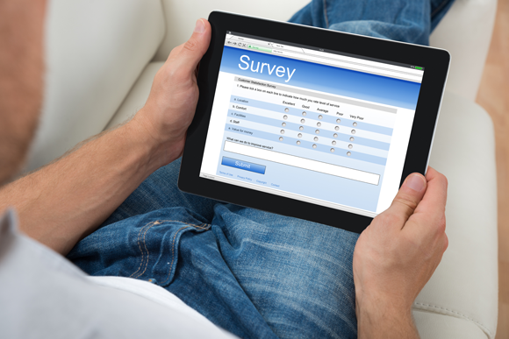
03
Customer Feedback Analysis
"Listening to Passengers: Extracting Insights from Customer Feedback"

Slide 14
Introduction
We delve into our efforts to improve the in-flight experience by analyzing customer feedback on food and beverages using advanced NLP techniques.
Studied the dataset named “Survey data_customer_comments”.
Data Preprocessing
Steps:
Removal of symbols, white spaces, and unique characters.
Implementing stemming and lemmatization for text normalization.
Tokenization for effective word separation.
Topic Modeling with LDA
Employing Latent Dirichlet Allocation (LDA) for topic modeling, we extracted pivotal topics from the processed text data.

Slide 15
Extracted Topics
Topic 1: Positive Aspects of In-Flight Experience
Topic 2: General Comments about United Airlines
Topic 3: Comparing In-Flight Choices and Comfort
Topic 4:Feedback on In-Flight Services and Quality
Topic 5: In-Flight Service and Beverage Quality
Sentiment Analysis
Using the VADER sentiment analysis from NLTK, each comment was analyzed for sentiment scores and labels.
Percentage of Positive Comments: 45.0976
Percentage of Negative Comments: 27.705
Percentage of Neutral Comments: 27.196

Slide 16
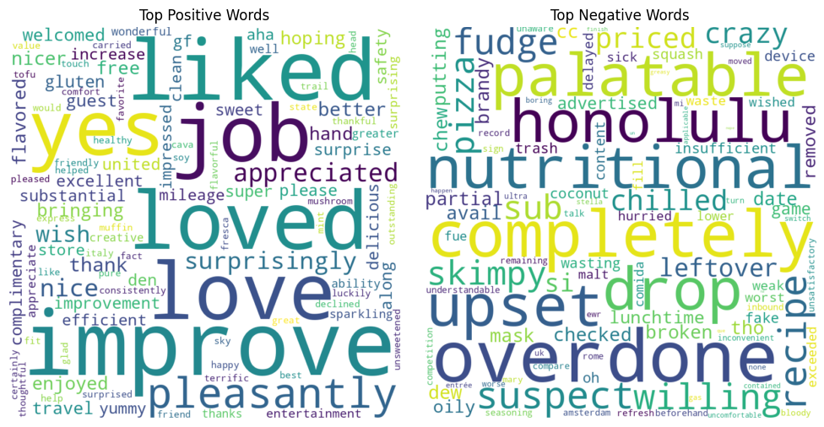
Positive and Negative Comment Analysis
The top words associated with both negative and positive comments are as follows:-

Slide 17
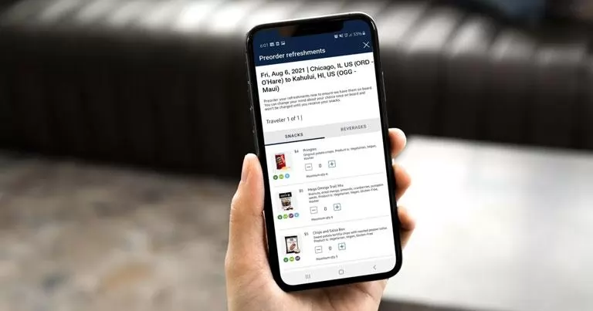
04
Pre-Order Data Analysis
"Unlocking Insights: A Comprehensive Analysis of Preorder Data"

Slide 18
OBJECTIVE
To understand why passengers don’t pre-book their meals Pre Booking meals is beneficial because:
For Airlines: Pre-booking meals streamlines catering operations, reduces food wastage, and enhances onboard service efficiency.
For Passengers: Pre-booking ensures personalized dining options, minimizes in-flight stress, and aligns with dietary preferences.
Through SQL analysis of our dataset, several noteworthy trends emerged regarding passengers' reasons for not pre booking meals and they are:
Preference for Not Eating: Some passengers opt out of pre-booking due to a lack of desire to eat during the flight.
Priority on Rest: Many travelers indicated a preference for sleep over eating during the flight.
United Airlines Membership: Some passengers rely on their United Airlines membership benefits to access pre-arranged meals.
Deciding Onboard: A notable portion of passengers prefer to decide their meal choice after boarding.

Slide 19
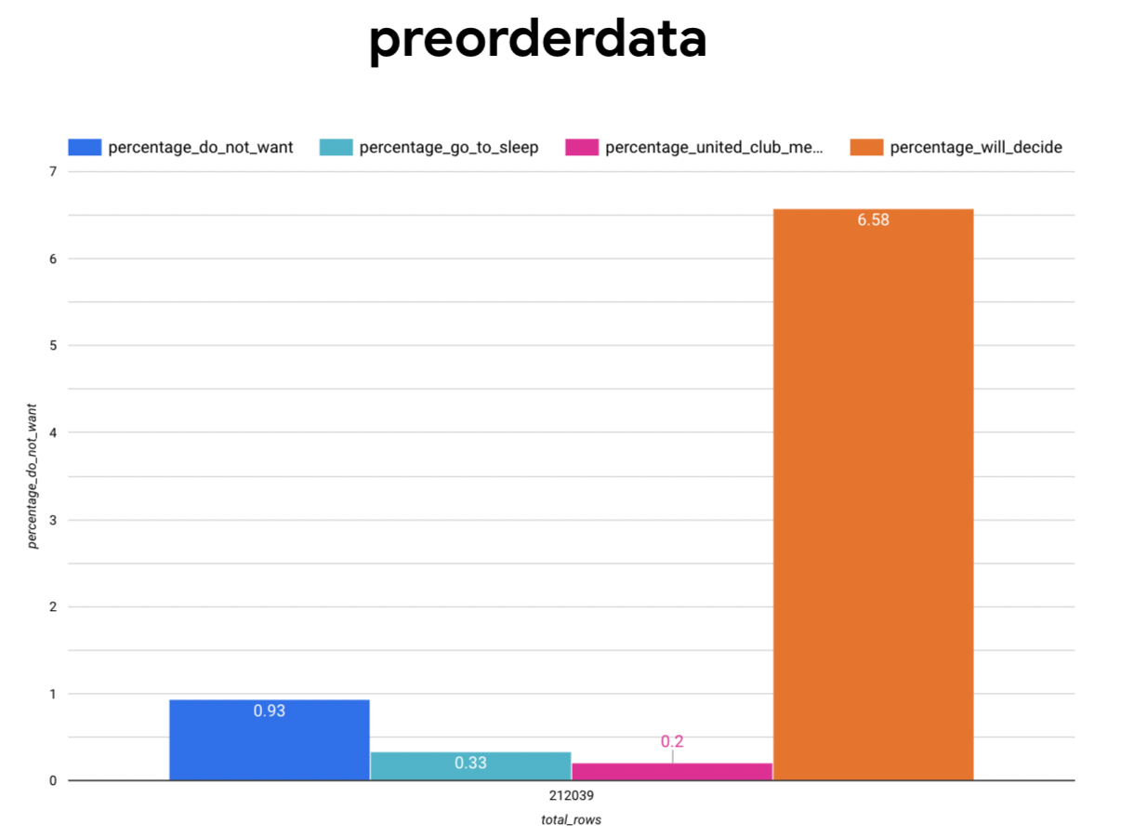

Slide 20
Query used:
SELECT
SUM(CASE WHEN meal_short_description LIKE '%I do not want to eat%' THEN 1 ELSE 0 END) AS num_do_not_want,
SUM(CASE WHEN meal_short_description LIKE '%I will decide onboard%' THEN 1 ELSE 0 END) AS num_will_decide,
SUM(CASE WHEN meal_short_description LIKE '%I would like to go directly to sleep%' THEN 1 ELSE 0 END) AS num_go_to_sleep,
SUM(CASE WHEN meal_short_description LIKE '%I am a United Club member and will eat there before my flight%' THEN 1 ELSE 0 END) AS num_united_club_member,
COUNT(*) AS total_rows,
(SUM(CASE WHEN meal_short_description LIKE '%I do not want to eat%' THEN 1 ELSE 0 END) / COUNT(*)) * 100 AS percentage_do_not_want,
(SUM(CASE WHEN meal_short_description LIKE '%I will decide onboard%' THEN 1 ELSE 0 END) / COUNT(*)) * 100 AS percentage_will_decide,
(SUM(CASE WHEN meal_short_description LIKE '%I would like to go directly to sleep%' THEN 1 ELSE 0 END) / COUNT(*)) * 100 AS percentage_go_to_sleep,
(SUM(CASE WHEN meal_short_description LIKE '%I am a United Club member and will eat there before my flight%' THEN 1 ELSE 0 END) / COUNT(*)) * 100 AS percentage_united_club_member
FROM `stalwart-summer-397109.UAhack.preorderdata`;

Slide 21
Business Suggestions
1. Strategic Regional Menu Planning:Curate a menu that strikes a balance between precision and diversity, offering region-specific dishes aligned with flight routes to provide passengers an authentic culinary experience.
2. Healthy Dining Choices: Incorporate a range of healthy meal options, catering to various dietary preferences and requirements, enhancing passenger well-being and satisfaction.
3. Business Class Upgrades:Introduce premium upgrades for business class passengers, providing an elevated dining experience that aligns with their expectations and enhances the overall journey.
4. Pre-Order Meal Offers: Encourage pre-ordering by offering exclusive discounts, deals, or coupons for passengers who choose their meals in advance, incentivizing proactive meal planning.

Slide 22
5. Festive Occasion Treats:Delight passengers during special occasions like Christmas, Eid, Diwali, etc., by offering celebratory treats that create a memorable and festive atmosphere onboard.
6. Meal-Linked Charitable Donations:Introduce a program where a portion of pre-booked meal proceeds are donated to charitable causes, allowing passengers to contribute positively while enjoying their meals.
7. Unified Privileges: Extend consistent privileges and offerings to all types of flights (domestic/international, short/long haul), ensuring a standardized and exceptional dining experience for all passengers.
8. Enhanced Staff Training:Invest in thorough training for staff during peak capacity periods to ensure top-tier service quality, regardless of flight occupancy.
9. Inventory Tracking Technology: Embrace advanced technology to monitor real-time meal inventory, minimizing food wastage and ensuring availability of preferred meal choices throughout the flight.

Slide 23
THANK YOU

